Slide 1
The rise of “world class” universities and changing scholarship in Taiwan Chuing Prudence Chou, National Chengchi University, Taiwan
AAS-in-Asia 2016, Doshisha University, Kyoto, Japan,
June 24-26, 2016

Slide 2
Abstract
In order to promote international-competitiveness and visibility, many Asian higher education institutes (HEIs) have strived for “world-class” universities.
Leading universities in East Asia have often favored faculty journal publication in the Science Citation Index (SCI), the Social Science Citation Index (SSCI) or other international publication indexes as major performance criteria for faculty.

Slide 3
Abstract
This study examines how faculty research performance has evolved and progressed in the last three decades in a public university in Taiwan. The study concludes that the forces of globalization and ranking have affected scholars differently depending on their field of study.
The phenomenon of“publish or perish” has been rising in Taiwan higher education.

Slide 4
What is ‘World Class’?
Publication of research in certain selected journals
Predominantly English-medium
Acceptance requires research appealing to a small number of editors
Homogenization and lack of plurality

Slide 5
Why ‘World Class’?
Globalization
Internationalisation
Government preference for Neo-liberal, market-based solutions
Rankings as both goal and measure (World-Class Research University Project, 2003; ‘5-year, NT$50bn’ plan).
Research output is the key

Slide 6
Specific measures
University Quality Assurance, used as benchmark for budget allocation
Monitor the publication records of individual faculty members in international and domestic journals
New hiring practices
Performance and evaluation systems
Thomson Reuters’ Science Citation Index (SCI), Social Science Citation Index (SSCI); and the Taiwan Social Science Citation Index (TSSCI) are the data sources for publication records.
Chosen to be as standardized and objective as possible to avoid accusations of bias.

Slide 7
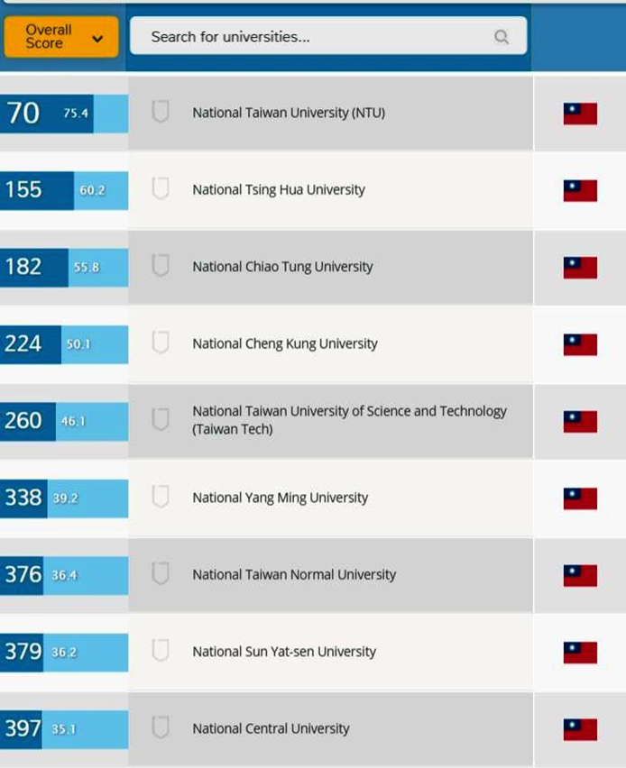
Short-term outcomes
Selected universities gained in international reputation.
Research publications rose by over 56% between 2008 and 2013 (World of Science, 2014).
Academic impact rankings showed no improvement (US still dominated.)

Slide 8
The paper aims to…
examine how higher education policies have re-oriented faculty research performance in two departments of a national university in Taiwan.
Each faculty journal publication was calculated from 1993, 2003 to 2013.
In-depth interviews were conducted among senior faculty.

Slide 9
Variations between disciplines
Education:
Faculty increasingly have quantitative backgrounds.
Papers on educational psychology, science education and educational technology boost research output.
Ethnography:
Interdisciplinary – difficulty in placing articles.
Requirement for long periods of field work.
Nature of disciplines affects publication rates.

Slide 10
Trends by Department
Education faculty began publishing more papers in English after 2003.
Ethnography faculty continued publishing primarily in Chinese.
Education faculty published mostly in Taiwanese journals before 2003; mostly in overseas journals after 2003.
Ethnography faculty published mostly in overseas journals before 2003; mostly in Taiwanese journals after 2003.
Faculty with quantitative backgrounds published more than faculty with qualitative backgrounds.

Slide 11
Promotion system
Probation and evaluation systems rely heavily on research journal publications.
Promotion rates within these departments showed correlation with journal publication rates.
3 education faculty achieved Professorial status within 10 years.
Ethnography has fewer full professors (2 out of 14 staff) and faculty were far more likely to remain in the same rank.
Faculty hired under post-2001 terms (6-year probation) tend to prioritize journal publication.

Slide 12
Trends in publication
Year | Ethnography* | Education*
1993 | 0.78 | 1.48
2003 | 0.78 | 1.67
2013 | 1.3 | 4.17
*Average number of papers published per faculty member per year.

Slide 13
Outcomes
Other academic endeavours are being de-prioritized in the quest for journal publication.
Successful promotion depends on publication in limited number of English-language journals. Local relevance is being lost.
Teaching and ‘public intellectual’ roles are falling behind.
Creates a ‘winner takes all’ environment amongst colleagues.
Education’s SSCI-relevant research output comes from a small number of staff.
Research topics are geared to appeal to journal editors, not be locally-relevant.
Ethnography’s low publication rate and mainly-Chinese medium make them less vulnerable to pressure.

Slide 14
Conclusion
Neoliberalism has driven great changes in the nature of academia.
Side effects call into question the relevance of research-based measures of excellence.
Urgent need to rebalance promotion criteria to encourage broader endeavour amongst faculty.

Slide 15
This paper contains preliminary findings as part of the “Measuring Up: The Intended and Unintended Consequencesof Global Competition and Metrics on Local Scholarship” project.
For further information, please refer to Special Issue of
Higher Education Policy (2016, winter).

Slide 16
Questions and Comments
Chou’s email: iaezcpc@gmail.com
Website: http://www3.nccu.edu.tw/~iaezcpc/renew_j_index.html
Books:
Taiwan Education at the Crossroad (2012).
The SSCI Syndrome in Higher Education (2014)
Chinese Education Models in a Global Age (2016)

Slide 17
ありがとう

